Slide 1


Investigating Ion-transport and thermal safety in functional polymer separators
Rishi Gupta, Robert K. Emmett, Margie Arcila-Velez, Jesse Kelly Mark E. Roberts
Dr. Roberts’ Research Group
Dept. of Chemical Engineering and Physics

Slide 2


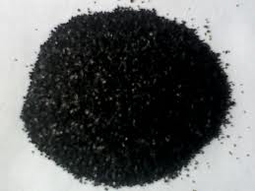
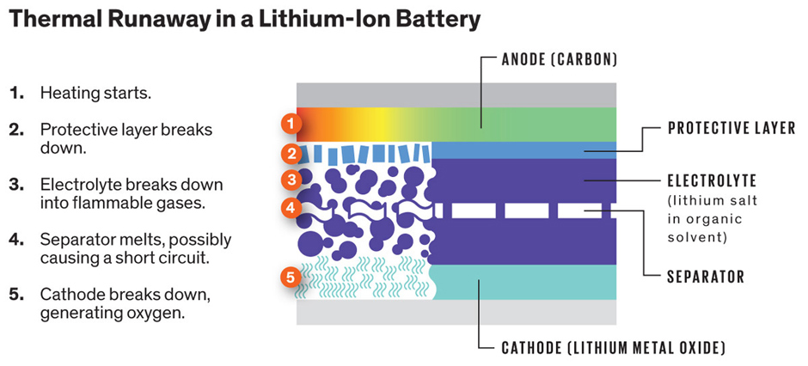
Motivation
Inefficient energy storage in lithium-ion batteries
  Harmful effects of current battery materials on the environment
  Carbon Materials
    Abundant in nature
    Unknown/variable electrochemical properties
    Thermal Runaway considerations
This work was part of the National Science Foundation REU Site: Advanced Functional Membranes at Clemson University. Support was provided by NSF under award EEC 1061524.

Slide 3
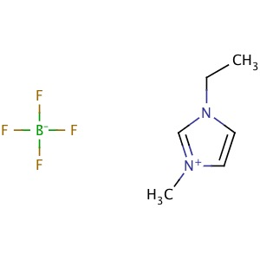
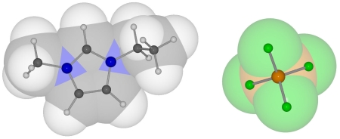
Objectives
Develop a smart material (electrolyte) that exhibits thermally responsive properties in nonaqueous systems
Ionic liquids (ILs) have negligible vapor pressure, are nonflammable, and thermally and chemically stable
Conductivity of systems remains constant or decreases above lower critical solution temperature (LCST)
This work was part of the National Science Foundation REU Site: Advanced Functional Membranes at Clemson University. Support was provided by NSF under award EEC 1061524.

Slide 4
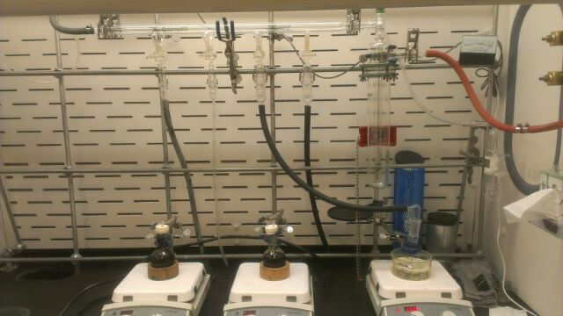
Ionic Liquids and Polymerization
Dissolve poly(ethylene oxide) (PEO) in 1-ethyl-3-methylimidazolium tetrafluroborate ([C₂mim][BF₄]) via stirring in vacuum and nitrogen for 1 hour then heating for 17 hours at 80°C
Purification of benzyl methacrylate monomer using basic alumina
Polymerization of poly(benzyl methacrylate) (pBzMA) using 2,2’-azobis (2-methylpropionitrile) at 65°C
This work was part of the National Science Foundation REU Site: Advanced Functional Membranes at Clemson University. Support was provided by NSF under award EEC 1061524.

Slide 5
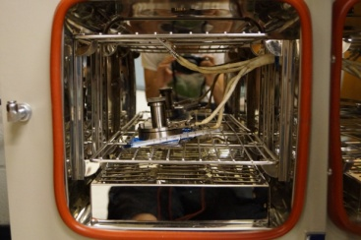
Experimental Methods
Electrolyte solution placed in flat cell
Cell placed in oven to allow changes in temperature
Conductivity measured via electrochemical impedance spectroscopy (EIS)
This work was part of the National Science Foundation REU Site: Advanced Functional Membranes at Clemson University. Support was provided by NSF under award EEC 1061524.

Slide 6
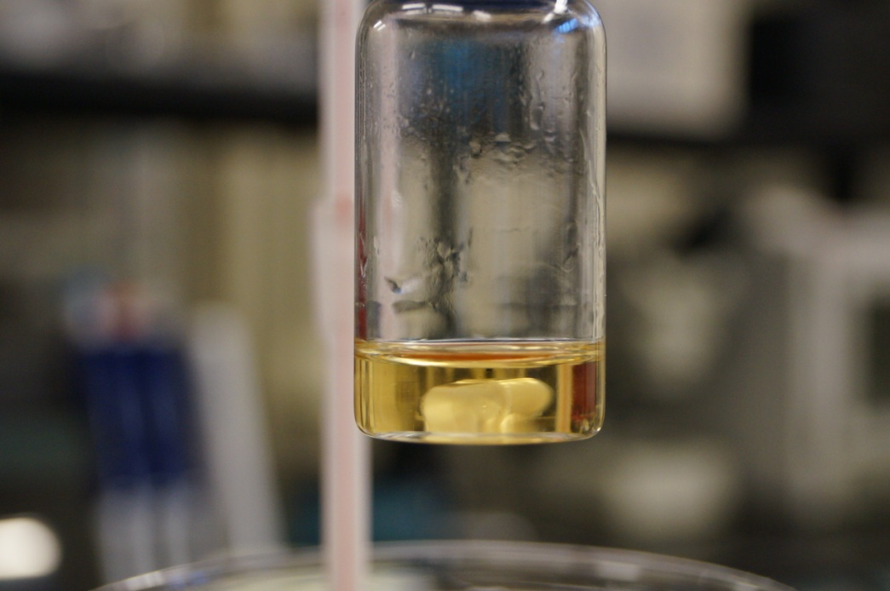
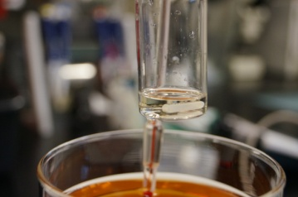
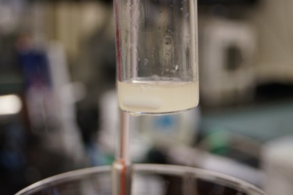
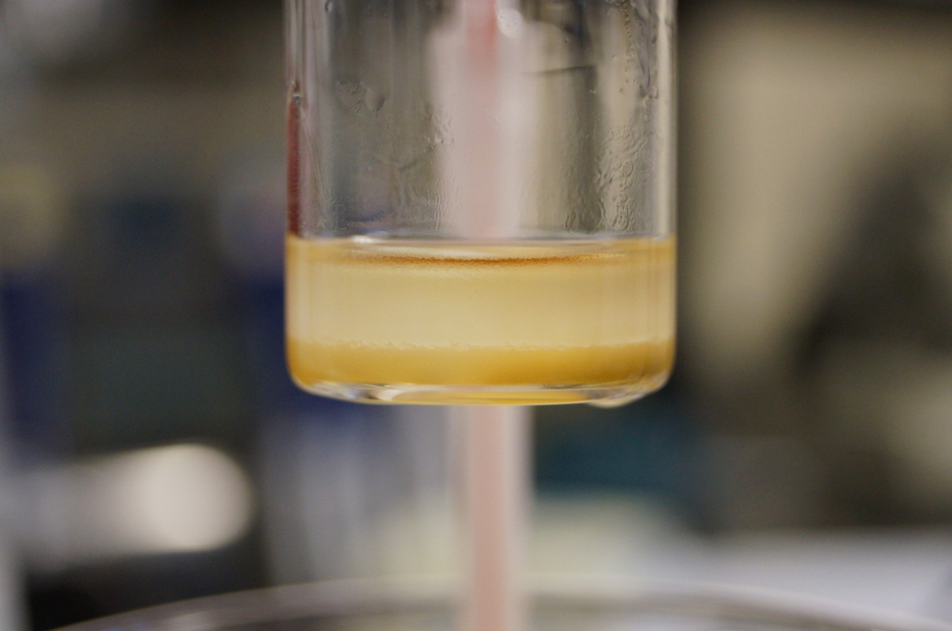
Results and Discussion
Phase separation occurs upon heating above LCST in PEO- [C₂mim][BF₄] and pBzMA- 1-ethyl-3-methylimidazolium bis(trifluoromethylsulfonyl)imide
This work was part of the National Science Foundation REU Site: Advanced Functional Membranes at Clemson University. Support was provided by NSF under award EEC 1061524.

Slide 7
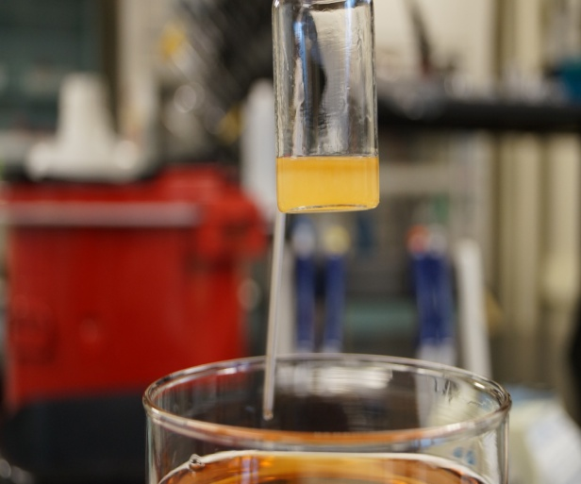
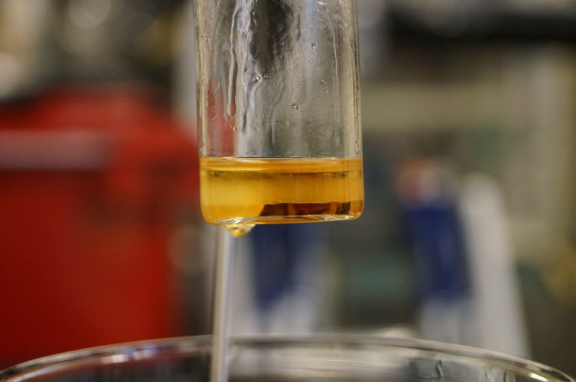
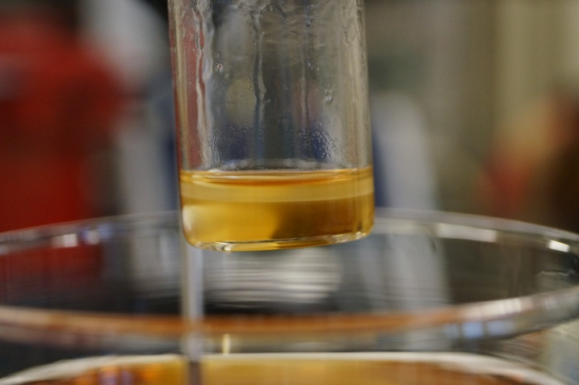
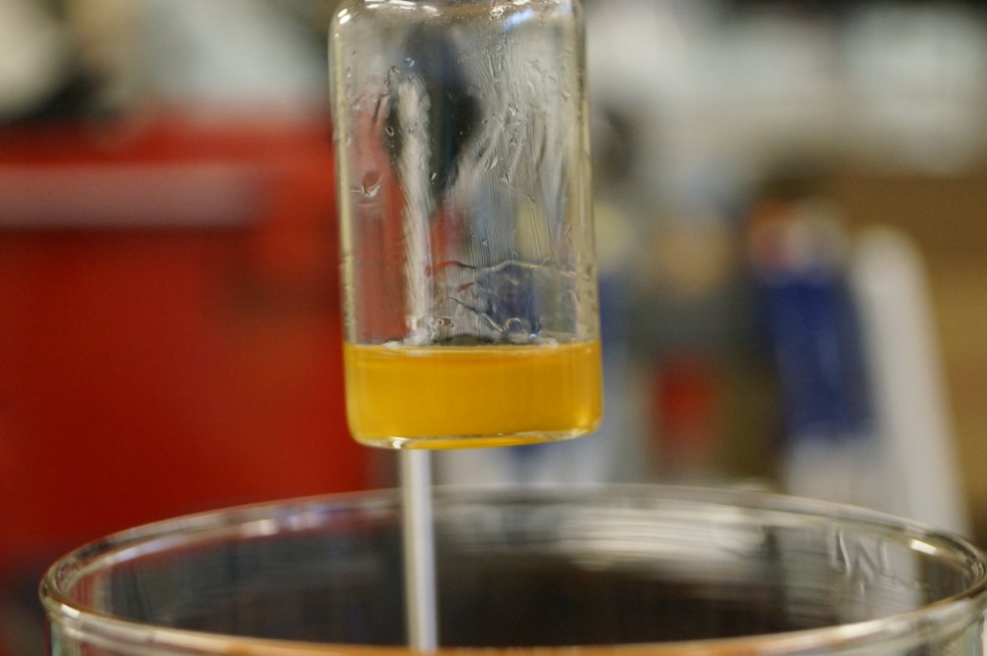
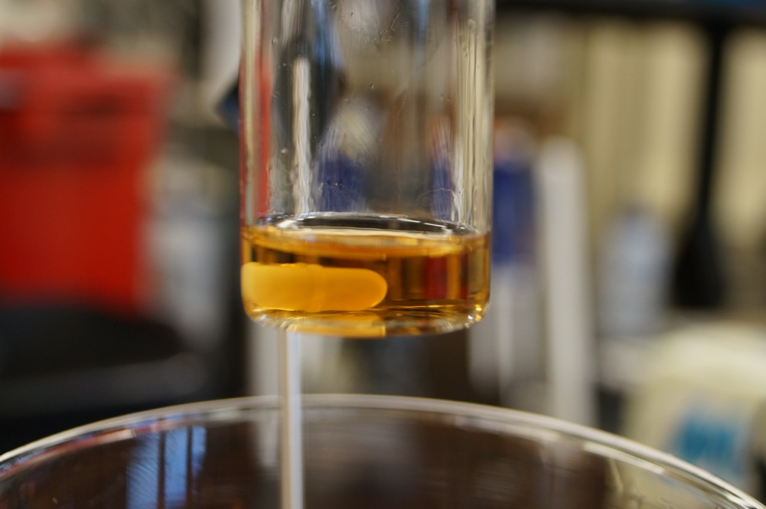
Results and Discussion
Phase separation occurs upon heating above LCST in PEO- [C₂mim][BF₄] solutions
This work was part of the National Science Foundation REU Site: Advanced Functional Membranes at Clemson University. Support was provided by NSF under award EEC 1061524.

Slide 8
Results and Discussion
Conductivity of [C₂mim][BF₄] increases with increasing temperature
Conductivity of PEO- [C₂mim][BF₄] systems decreases above LCST
This work was part of the National Science Foundation REU Site: Advanced Functional Membranes at Clemson University. Support was provided by NSF under award EEC 1061524.

Slide 9
Results and Discussion
Conductivity of [C₂mim][BF₄] increases with increasing temperature
Conductivity of PEO- [C₂mim][BF₄] systems decreases above LCST
This work was part of the National Science Foundation REU Site: Advanced Functional Membranes at Clemson University. Support was provided by NSF under award EEC 1061524.

Slide 10

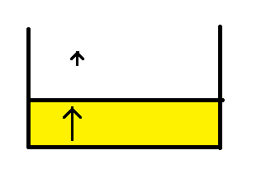
Results and Discussion
Phase separation leads to higher resistance
Lower ion mobility in PEO phase
This work was part of the National Science Foundation REU Site: Advanced Functional Membranes at Clemson University. Support was provided by NSF under award EEC 1061524.

Slide 11
Future Work
Add lithium salts to PEO, [C₂mim][BF₄], and PEO- [C₂mim][BF₄] mixtures and again test conductivity with temperature
This work was part of the National Science Foundation REU Site: Advanced Functional Membranes at Clemson University. Support was provided by NSF under award EEC 1061524.

Slide 12

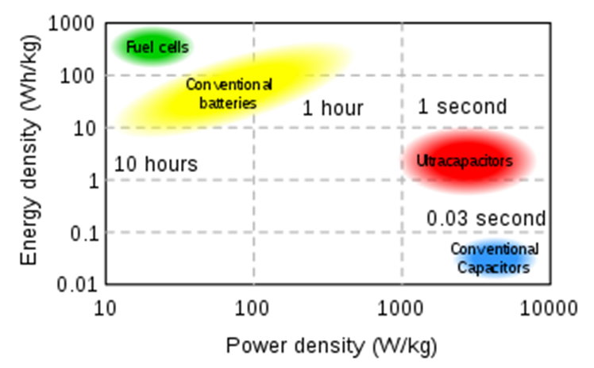
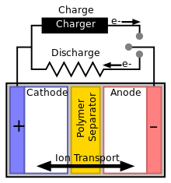
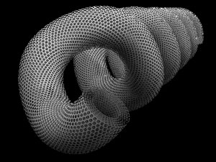
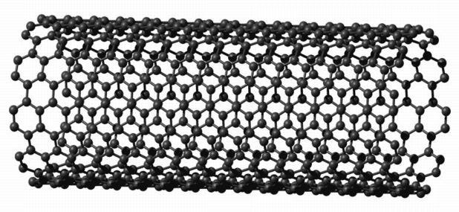
Supercapacitors
    Supercapacitors causes current through charge separation
    Porous membranes divide the electrodes
      Prevents shorting
    Carbon Nanotube Bucky Papers
      Aromatic structure
      nanocoils
This work was part of the National Science Foundation REU Site: Advanced Functional Membranes at Clemson University. Support was provided by NSF under award EEC 1061524.

Slide 13
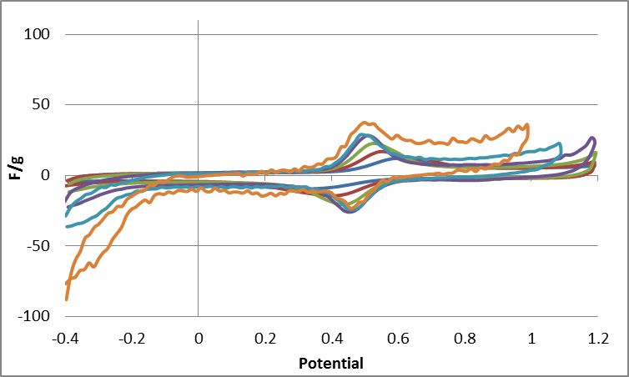
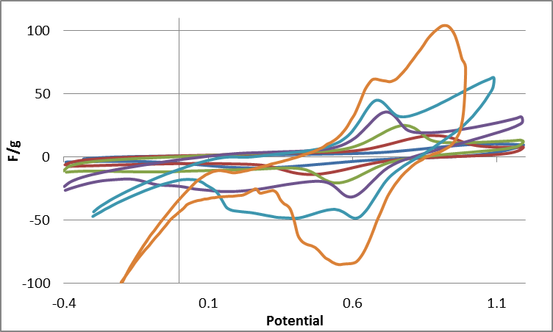
Electrolytes
1M HClO4
Nonaqueous electrolytes
  Wider voltage range
  Propylene carbonate/acetonitrile
  LiClO4, TBAF
Aqueous electrolytes
  Strong acids
  Smaller Ions have more mobility
    Less peak separation
    Tartic Acid does not corrode metals
1M Tartic Acid
Kelly, J. C., et al. "Reversible Control of Electrochemical Properties using Thermally-Responsive Polymer Electrolytes." Advanced Materials 24.7 (2012): 886-9. Web
This work was part of the National Science Foundation REU Site: Advanced Functional Membranes at Clemson University. Support was provided by NSF under award EEC 1061524.

Slide 14
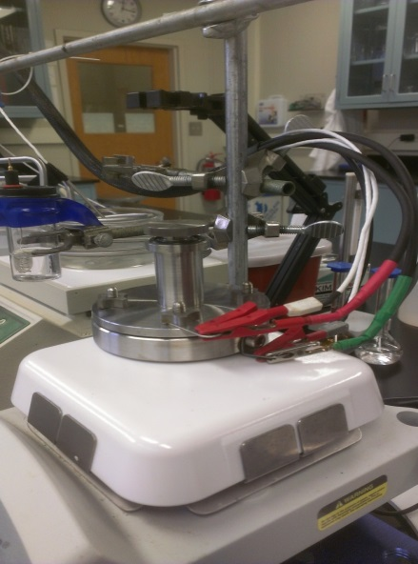
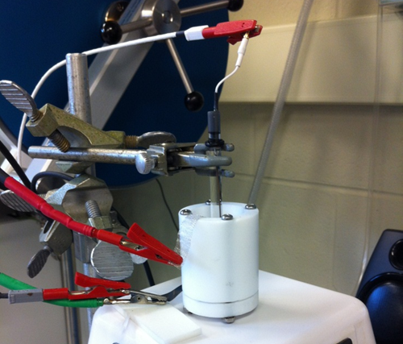
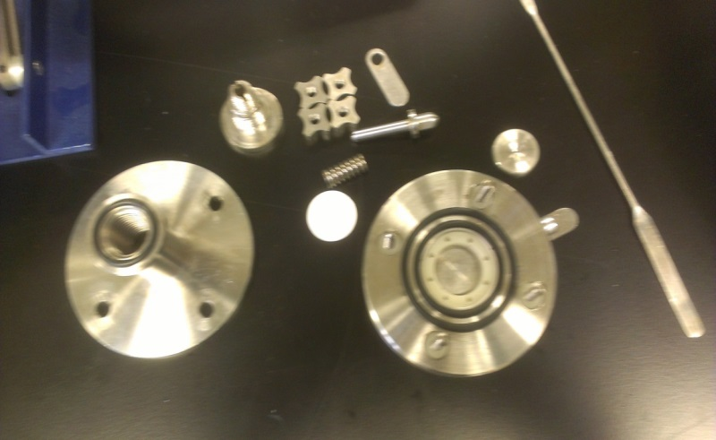
Experimental Setup
Electrochemical Treatment
  Potential sweeps chemically alter the film
  “activates” Fe remaining after synthesis
  CV scans are run until steady state is reached
  Analysis and characterization
    Standard battery analysis
    Determines how the film is altered
This work was part of the National Science Foundation REU Site: Advanced Functional Membranes at Clemson University. Support was provided by NSF under award EEC 1061524.

Slide 15
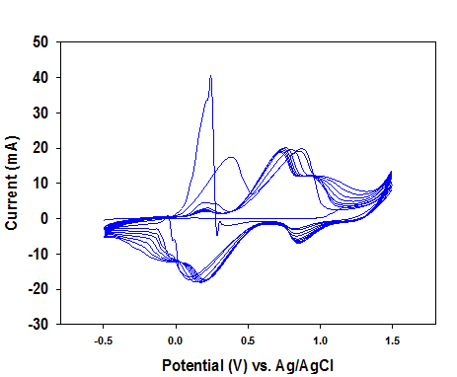
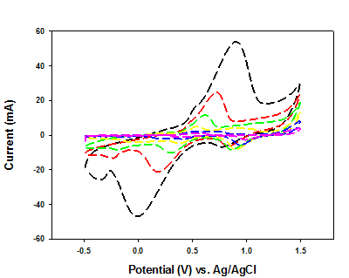
Cyclic Voltammetry (CV)
Film changes properties
Scanned until a steady state
Different Scan Rates
Shows electrochemical response w/ discharge time
Calculate capacitance
This work was part of the National Science Foundation REU Site: Advanced Functional Membranes at Clemson University. Support was provided by NSF under award EEC 1061524.

Slide 16
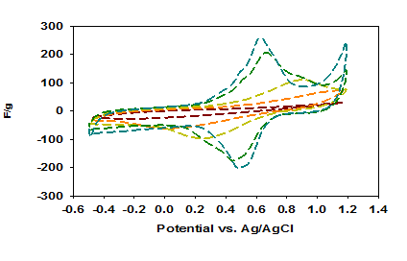
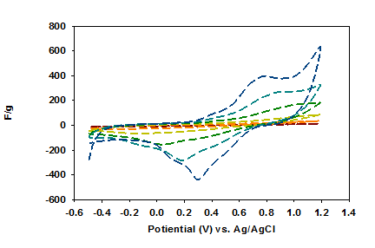
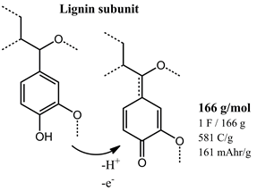
Lignin Modification
Second most abundant macromolecule
Used with acid electrolyte
Broadens redox peaks/ increases peak separation
Adsorption technique
This work was part of the National Science Foundation REU Site: Advanced Functional Membranes at Clemson University. Support was provided by NSF under award EEC 1061524.

Slide 17
RIE with Lignin
120s
90s
60s
30s
NC
120s
NC
30s
60s
90s
Argon etching increases surface area
Films soaked in lignin
No change without lignin
This work was part of the National Science Foundation REU Site: Advanced Functional Membranes at Clemson University. Support was provided by NSF under award EEC 1061524.

Slide 18
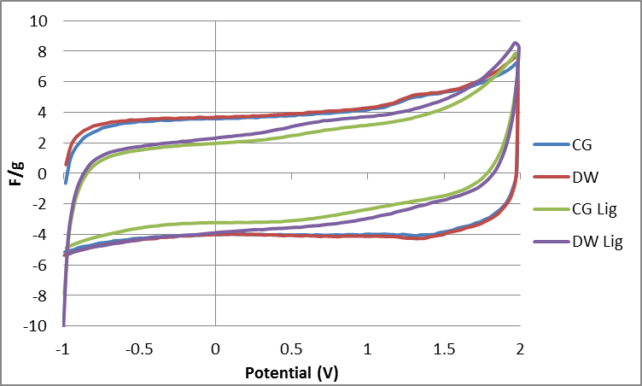
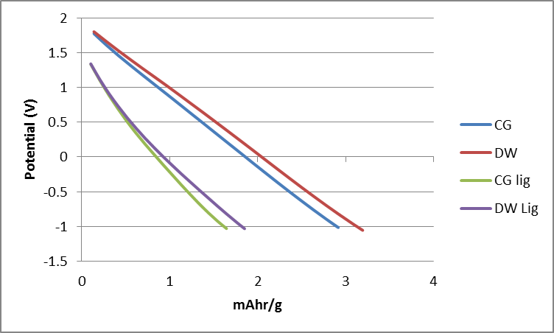
Separator testing
Scan 0.01 V/s
Charge/discharge data
DW separators show slightly better performance
Lignin has unexpected result in this data
This work was part of the National Science Foundation REU Site: Advanced Functional Membranes at Clemson University. Support was provided by NSF under award EEC 1061524.

Slide 19
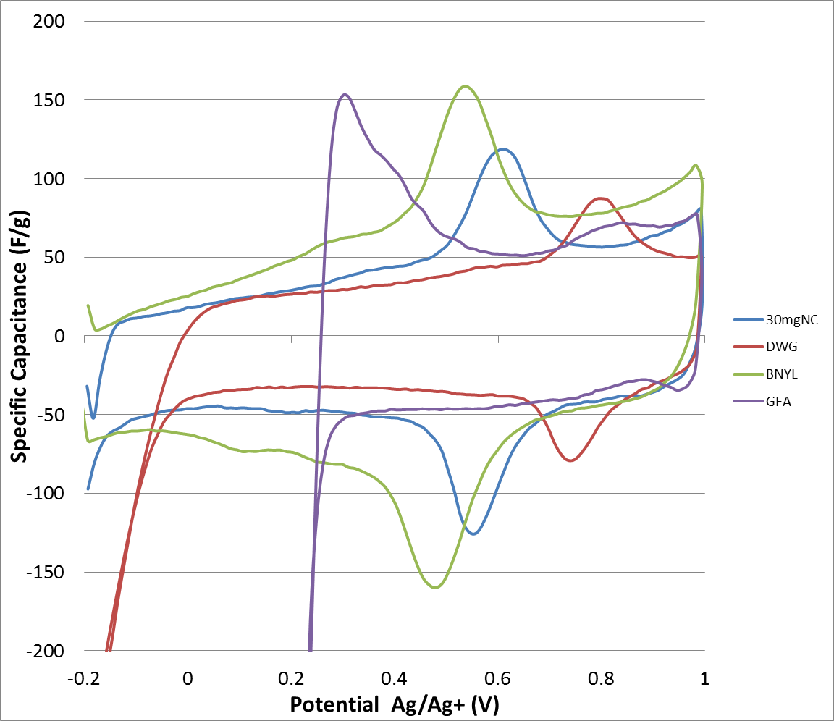
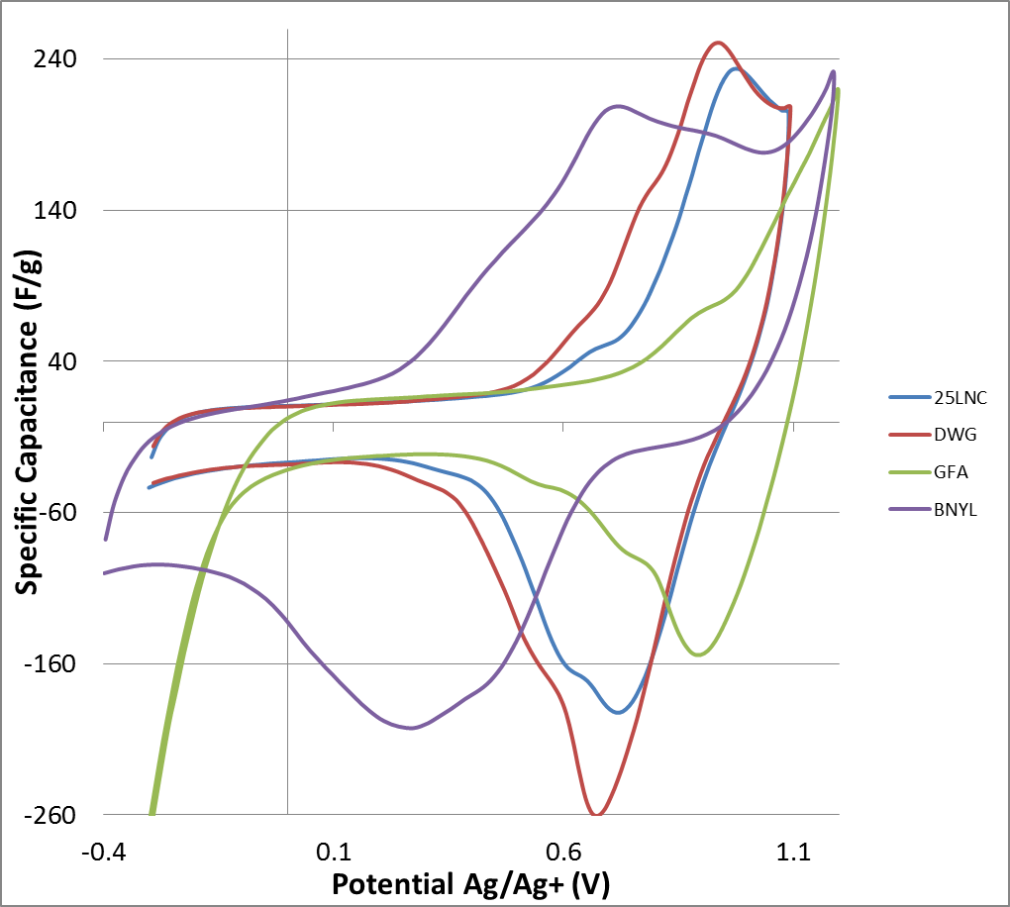
Resistance of Separators
V/R=I, Variation of Ohm’s Law
Larger current mean larger capacitances
Nylon and Filter show best performance
Consistent between lignin and non-lignin films
3mVs Nanocoil
10mVs Lignin Nanocoil
This work was part of the National Science Foundation REU Site: Advanced Functional Membranes at Clemson University. Support was provided by NSF under award EEC 1061524.

Slide 20

Conclusions
Created a smart material that can lower conductivity with increasing temperature via LCST behavior
Electrolyte that safely shuts down batteries to prevent thermal runaway
Tartic acid does not corrode metals
Incorporating Lignin Increases Capacitance
RIE Increases surface area of the substrate
Nylon Membranes/Filter Paper membranes show best characteristics
This work was part of the National Science Foundation REU Site: Advanced Functional Membranes at Clemson University. Support was provided by NSF under award EEC 1061524.

Slide 21
Acknowledgements
National Science Foundation
NASA
Dr. Arjun Rao
This work was part of the National Science Foundation REU Site: Advanced Functional Membranes at Clemson University. Support was provided by NSF under award EEC 1061524.

